Slide 1
Customer Personality Analysis
Analysis of company's ideal customers
Uswatun Hasanah

Slide 2

Background
Customer personality analysis helps a business to modify its product based on its target customers from different types of customer segments

Slide 3
Data PreProcessing

Slide 4
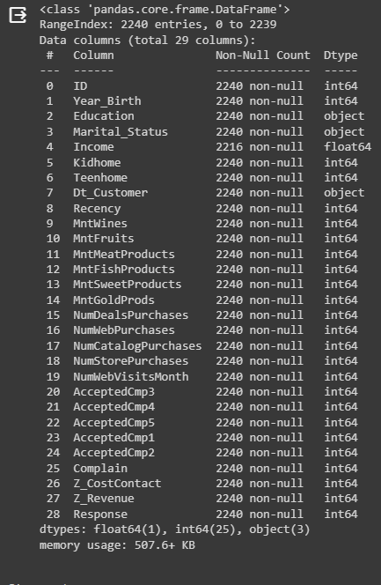
About The Dataset
Subsets
Data contains 29 columns with 2240 rows
People
ID
Year_Birt
Education
Marital_Status
IncomeKidhome
Teenhome
Dt_Customer
Recency
Complain
ProductsID
MntWines
MntFruits
MntMeatProducts
MntFishProducts
MntSweetProducts
MntGoldProds
Promotion
NumDealsPurchases
AcceptedCmp1
AcceptedCmp2
AcceptedCmp3
AcceptedCmp4
AcceptedCmp5
Response
Place
NumWebPurchases
NumCatalogPurchases
NumStorePurchases
NumWebVisitsMonth

Slide 5
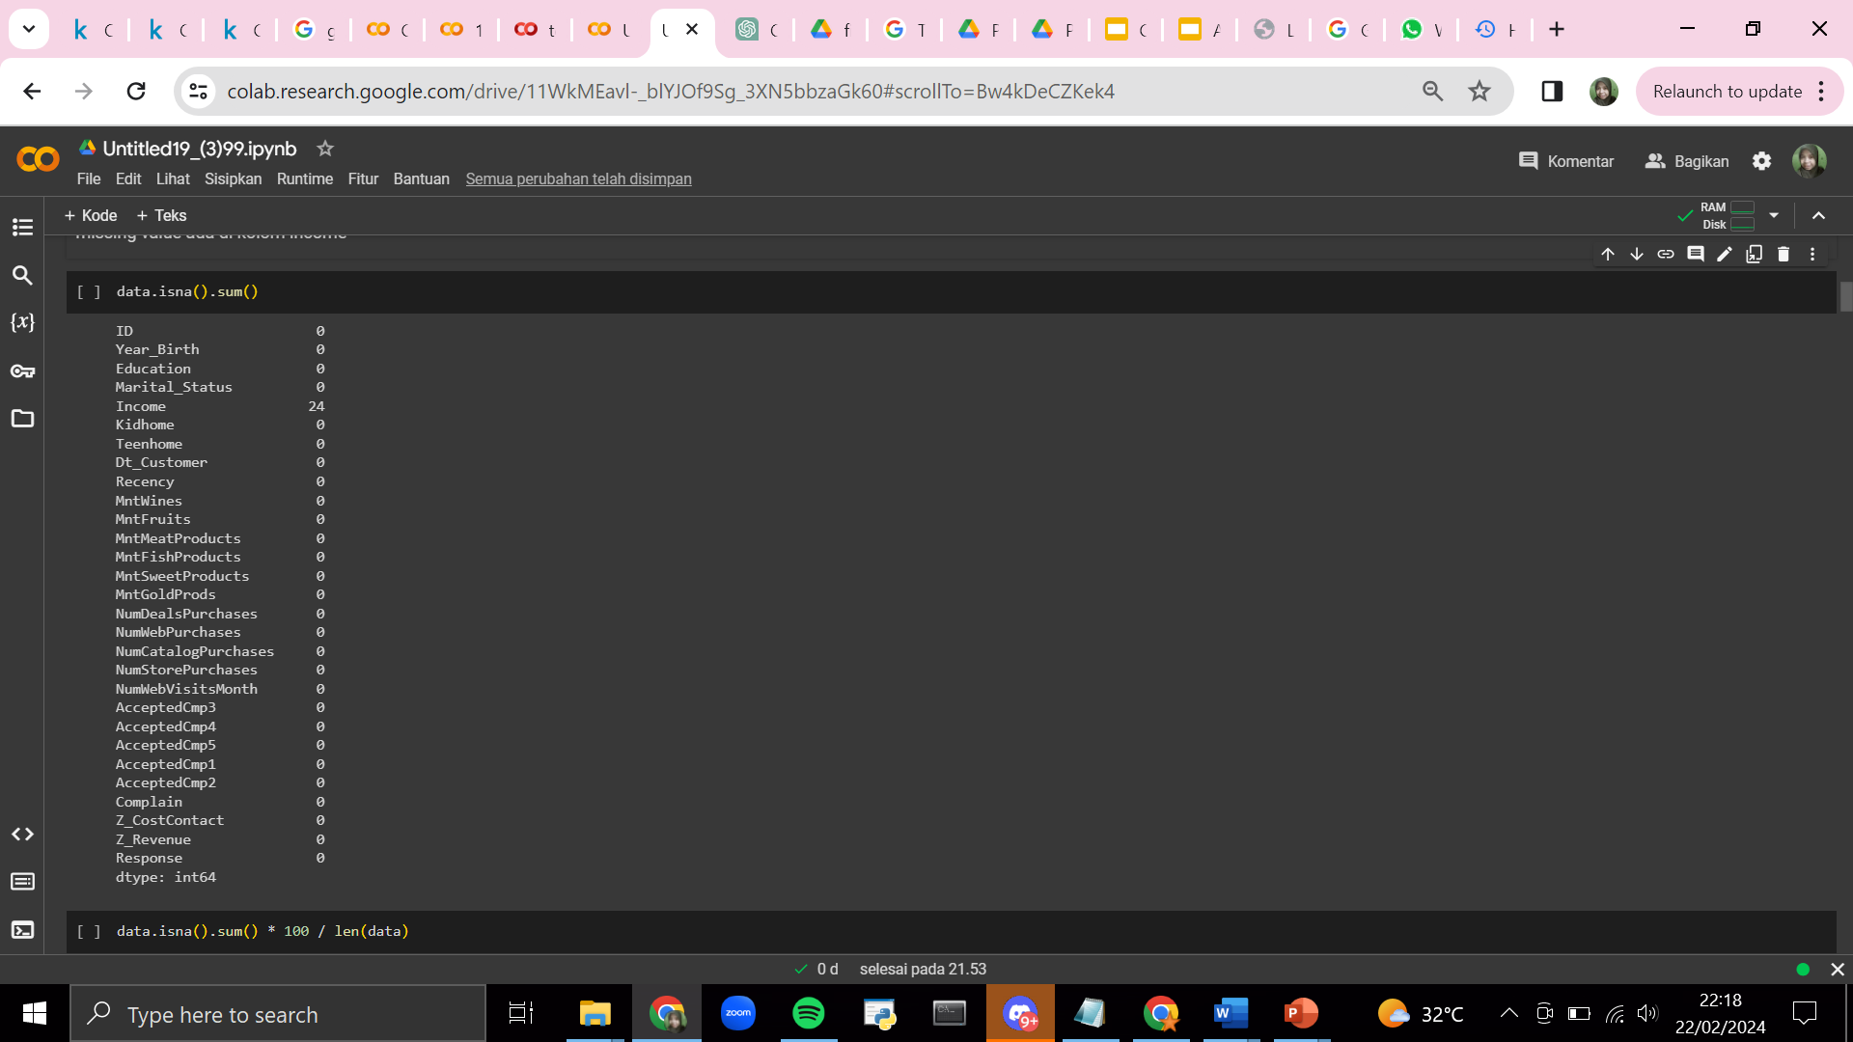

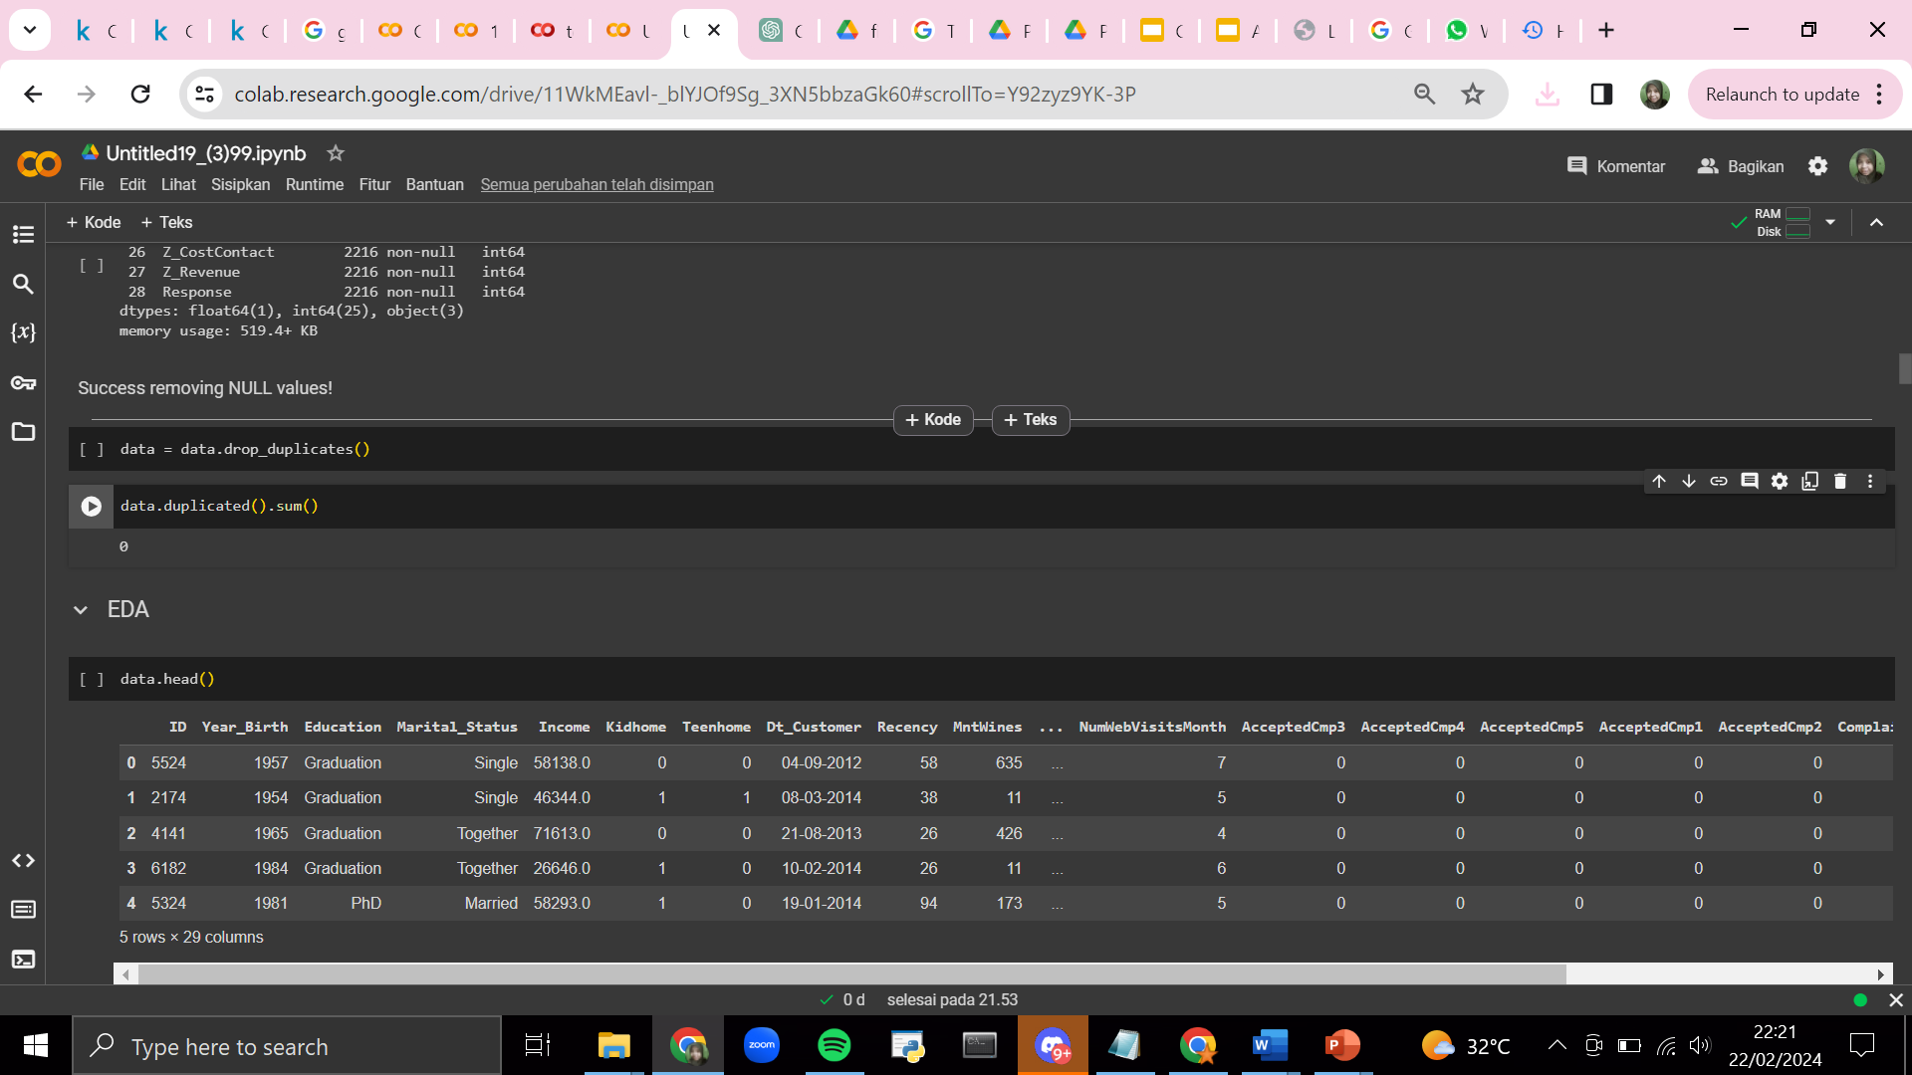
Drop Missing Value and Duplicates

Slide 6
EDA

Slide 7
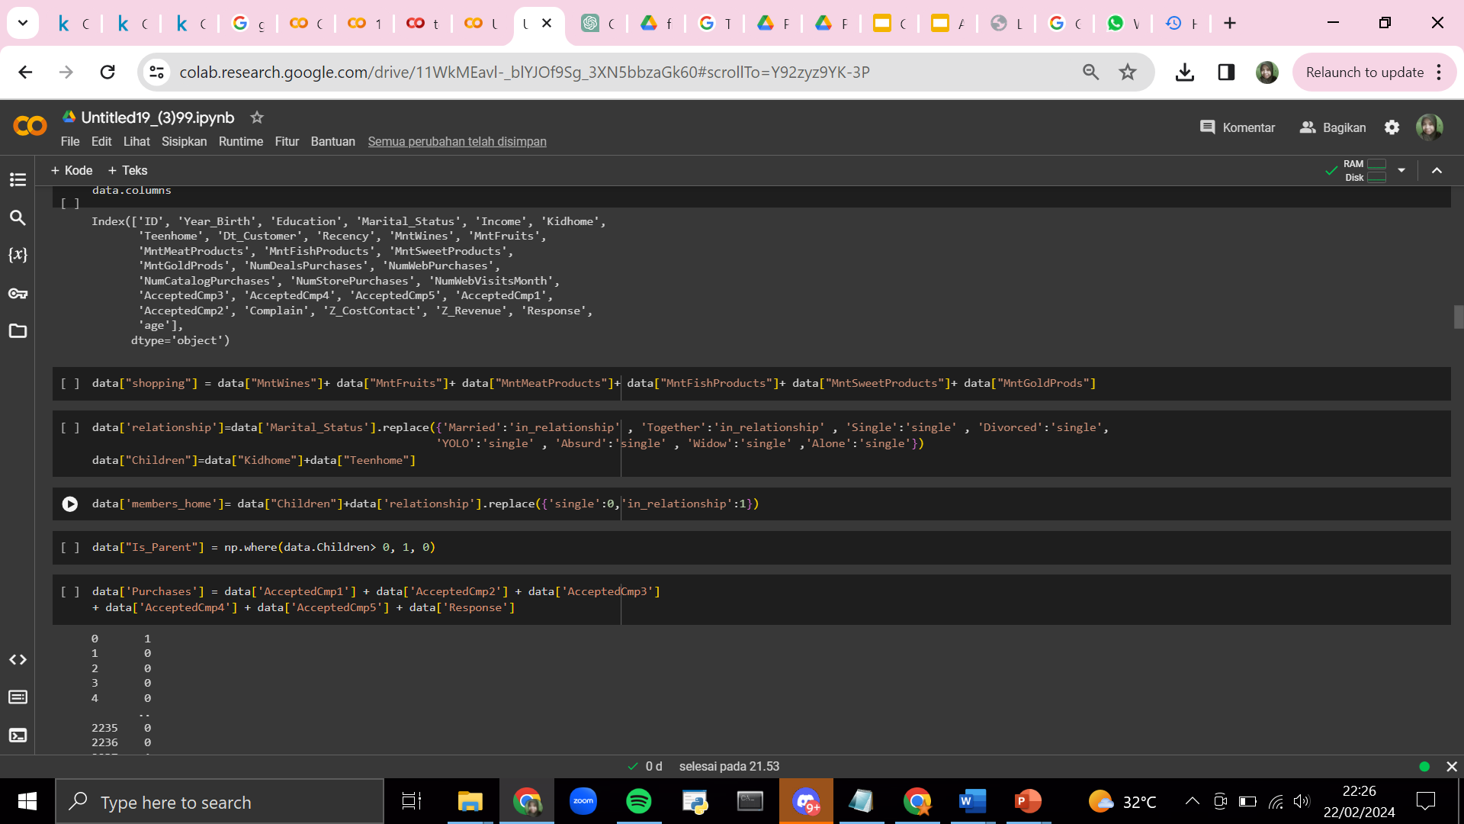
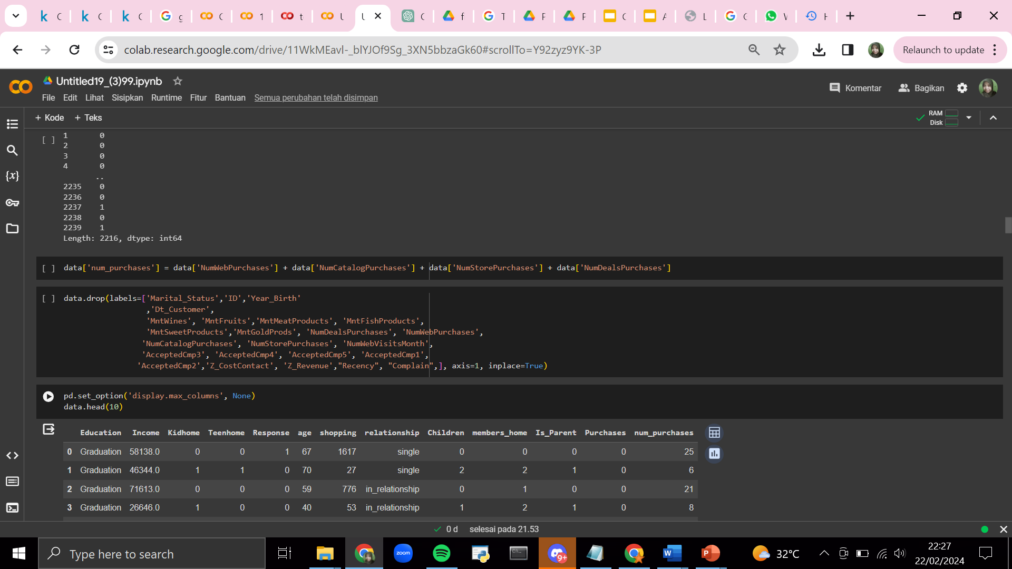
Simplifying the features

Slide 8
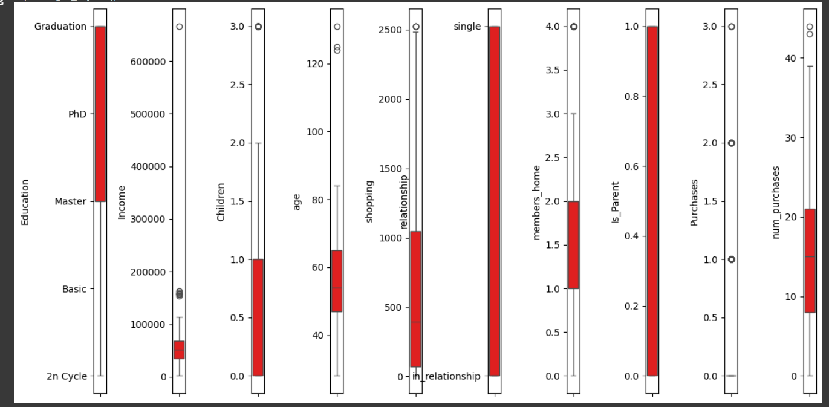
outlier
Outlier :
Income
Age

Slide 9
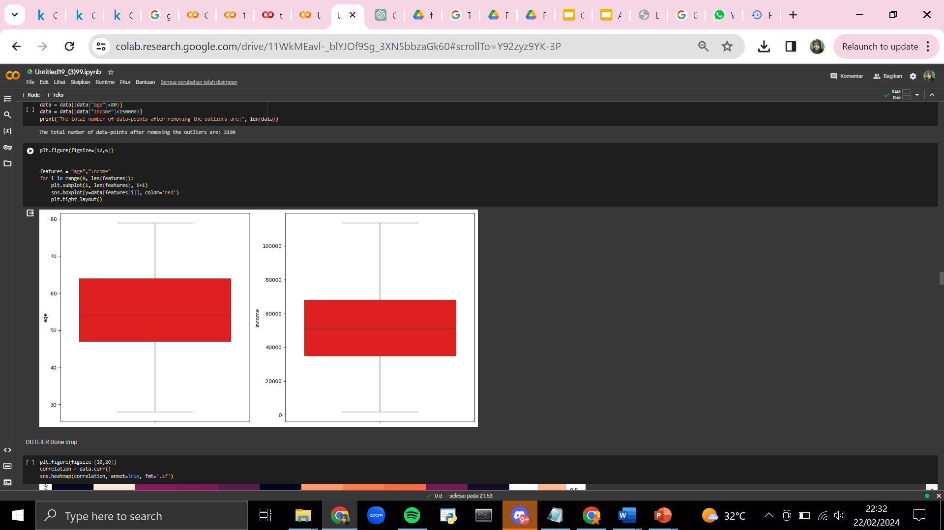
Outlier done drop

Slide 10
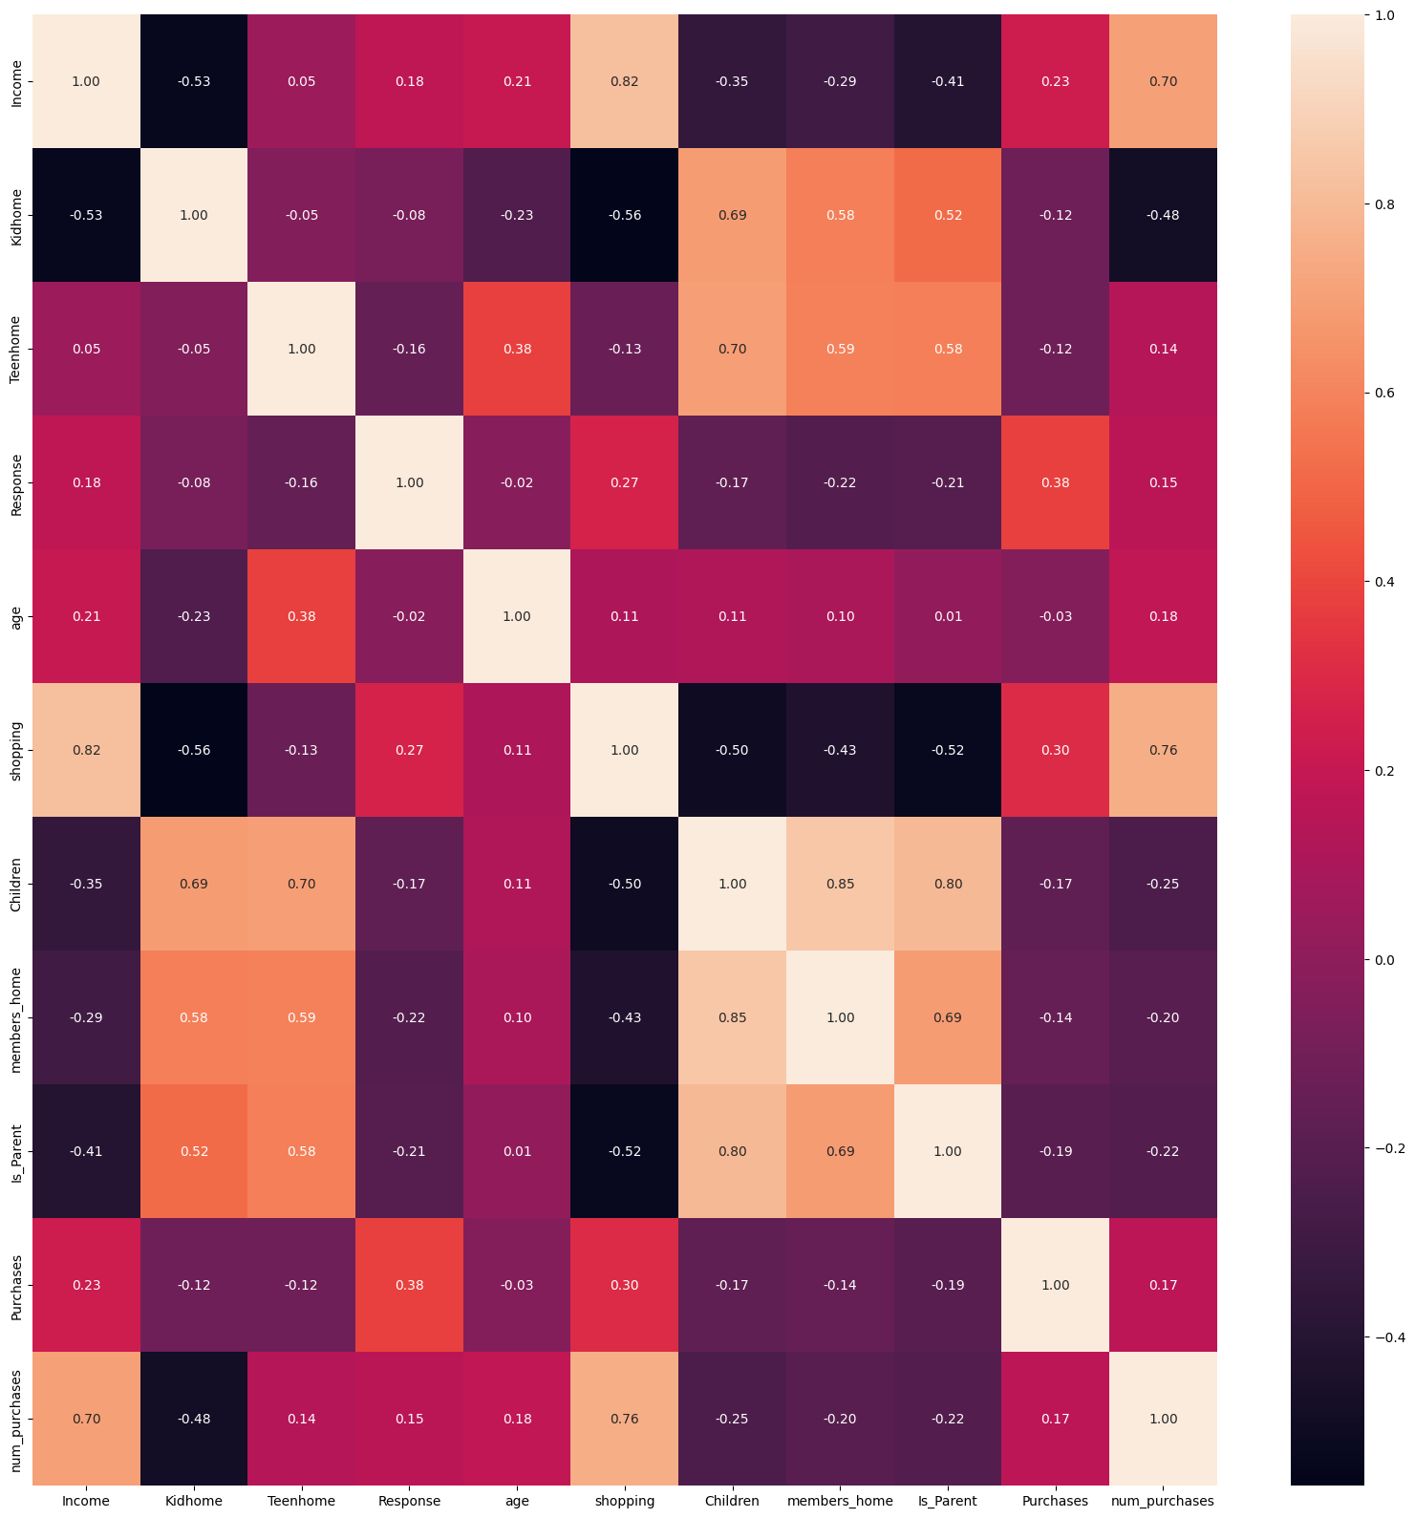
correlation amongst the features

Slide 11
CLUSTERING

Slide 12
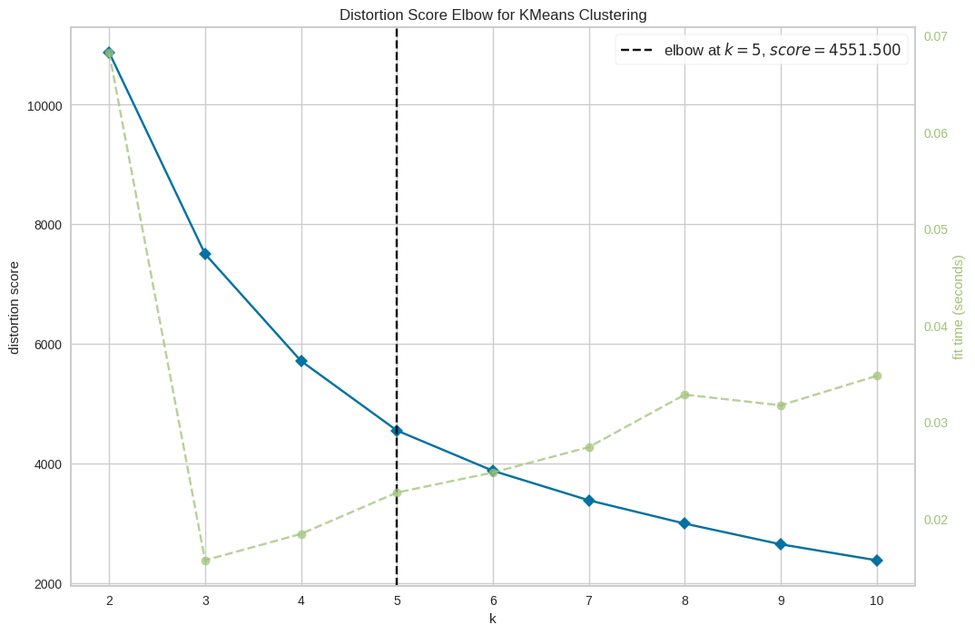
Score plot
The result of the score plot can be taken as the best and ideal value, which is at point 5, or N = 5
“
”

Slide 13
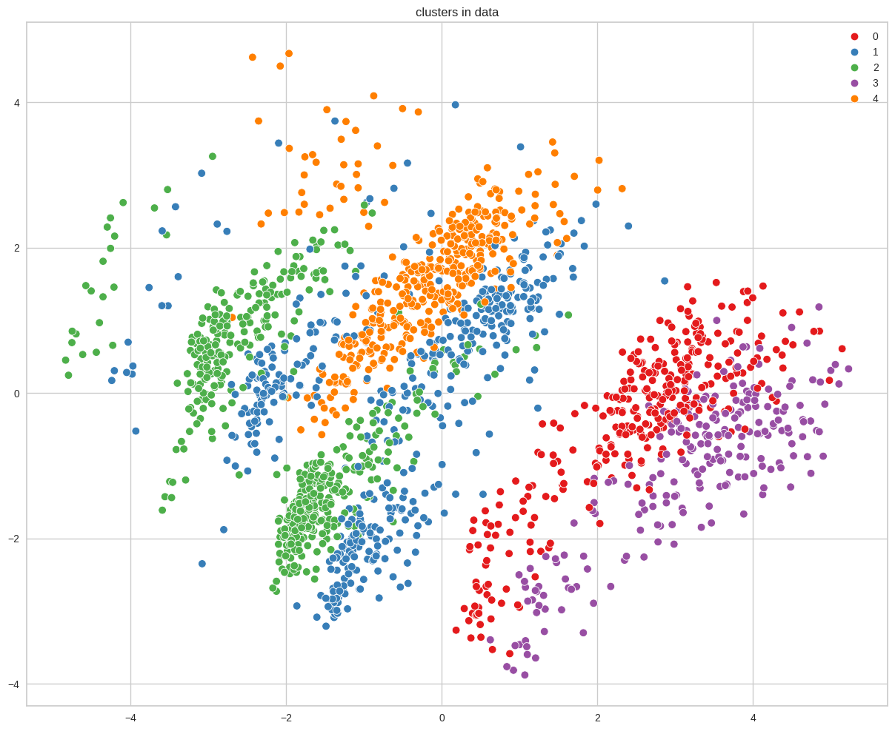
From the results of this customer clustering and visualized with a scatterplot as shown below.
This diagram shows the distribution of customer data which is divided into clusters according to the K-Means Clustering algorithm.

Slide 14
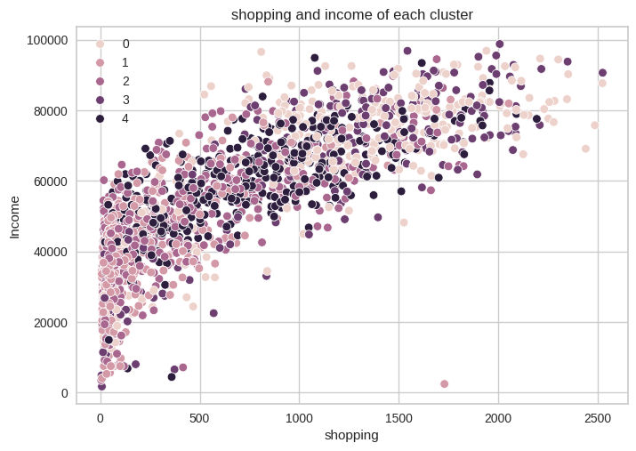
shopping capabilities and income for each cluster
Income vs shopping plot shows the clusters pattern
cluster 1: high shopping & high income
cluster 2: most are low shopping and income, but some are in high.
cluster 3 & 4: most are low shopping and income
cluster 5 : high shopping & low income

Slide 15
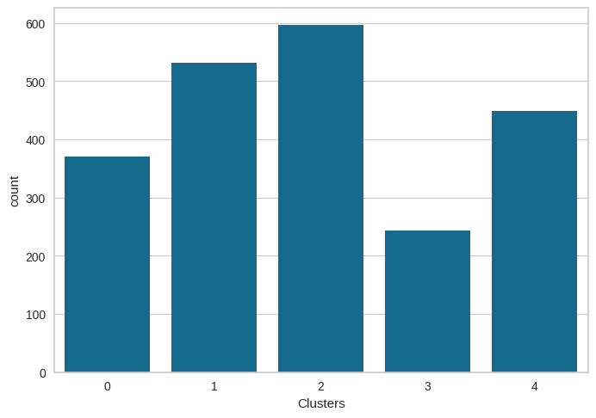
the count of each cluster

Slide 16
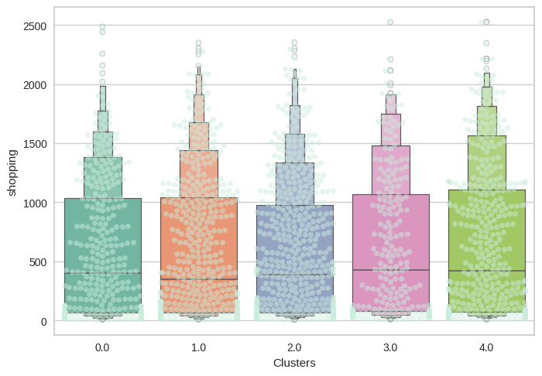
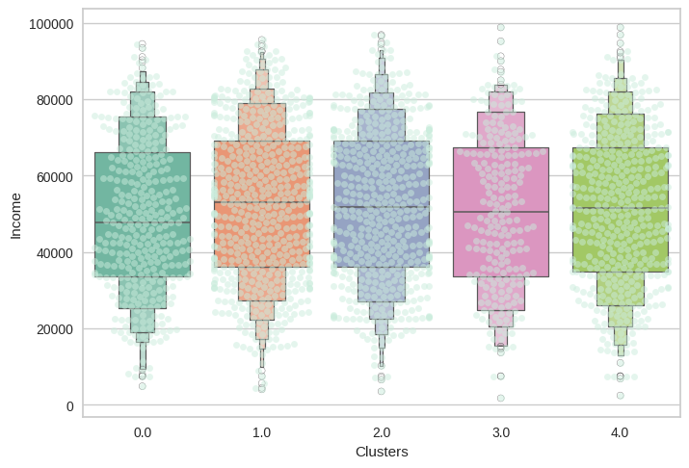
shopping capabilities of each cluster
Income each cluster

Slide 17
PROFILING

Slide 18
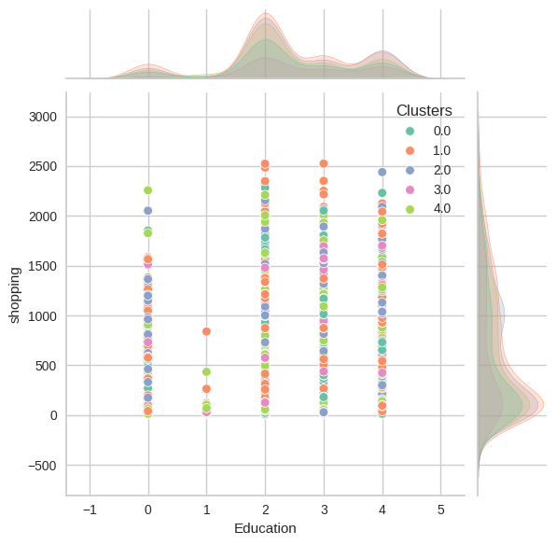
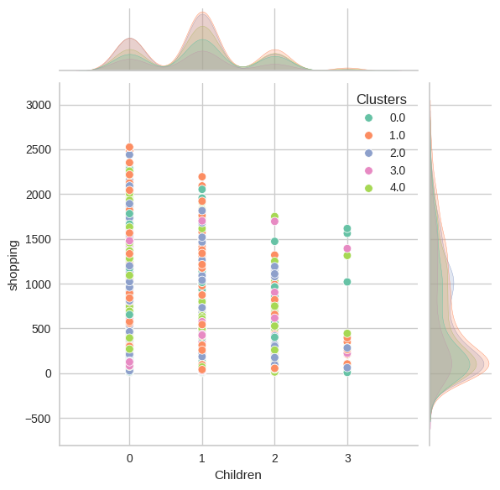
plotting some of the features that are indicative of the customer's personal traits in light of the cluster they are in.

Slide 19
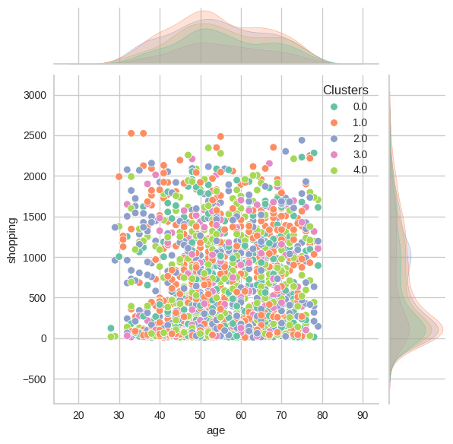
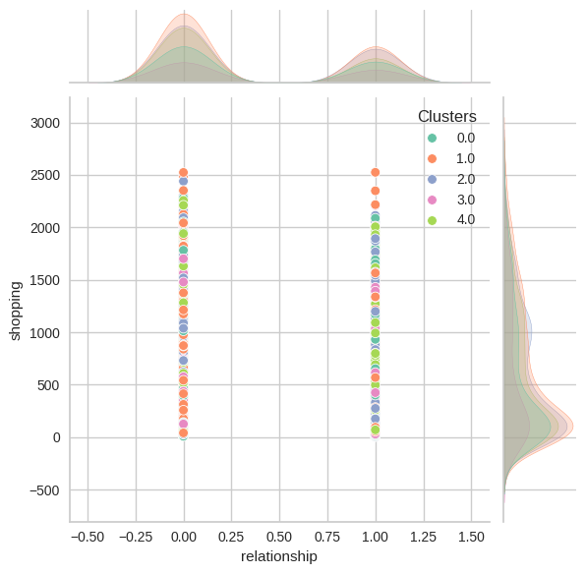

Slide 20
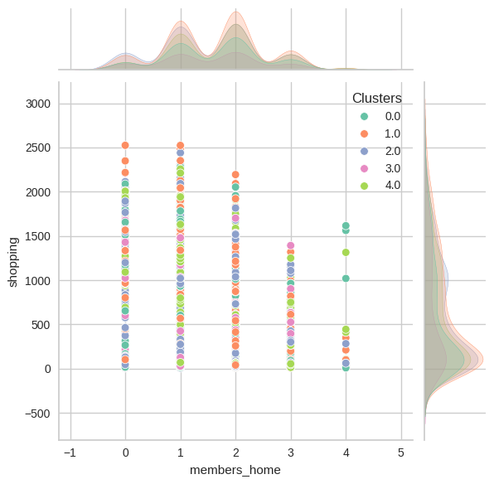
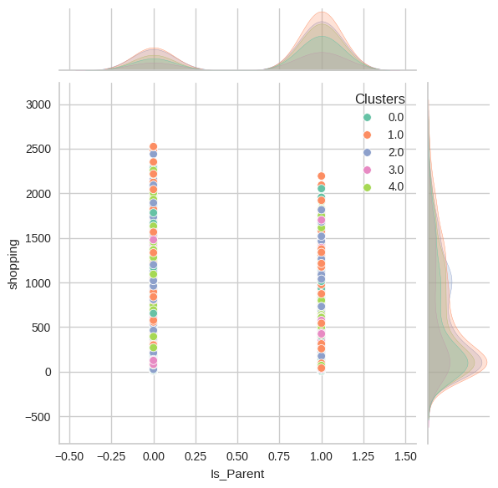

Slide 21
Profiling The Clusters
Cluster 1
Cluster 2
age around <30 - <80
the majority of these people are single living.
Some have kids and teenagers at home
have 4 members in the family
High income and spent
age around >30- <80, but most in <70
the majority of these people are in relationship not single living
a highest capability shopping
have 4 members in the family
Cluster 3
age around >30- <80
more are single category
the majority of these people are in relationship not single living
have 4 members and 0 members in the family
Largest number of cluster members

Slide 22

Cluster 4
Cluster 5
age around <30 - <80
more are in relationship
have 3 members in the family
most have kids and teenager at home
smallest number of cluster members
>40 tahun s/d <80 tahun
single and relationship almost the same
most have 1 members in the family
kid and teenager are not dominant in this group

Slide 23

CONCLUSION & RECOMMENDATION

Slide 24

memanfaatkan cluster 2 untuk memperbanyak penawaran produk, karena dari hasil penjualan terahir, cluster 2 paling tinggi diantara cluster yang lain dan mayoritas cluster 2 mempunyai anggota keluarga yang banyak

Slide 25

Cluster 3, mempunyai jumlah anggota paling sedikit daripada cluster lain, dari kapabilitas pembelian produk juga paling sedikit, dari segi income juga termasuk rendah dibandingkan dengan cluster lain, ini menjadi perhatian bagi bisnis, untuk dapat meningkatkan penjualan dari pelanggan cluster 3, bisa dengan melakukan promo diskon pada barang yang sering dibeli oleh customer di cluster 3.

Slide 26
THANK YOU
Have any questions ?
www.linkedin.com/in/uswatun-hasanah-20b84a27b
chasanah35@gmail.com
Source
https://www.kaggle.com/datasets/imakash3011/customer-personality-analysis
https://slidesgo.com

